Slide 2
Topics
Introduction to File Input and Output
Using Loops to Process Files
Processing Records
Exceptions

Slide 3
Introduction to File Input and Output
For program to retain data between the times it is run, you must save the data
  Data is saved to a file, typically on computer disk
  Saved data can be retrieved and used at a later time
“Writing data to”: saving data on a file
Output file: a file that data is written to

Slide 4
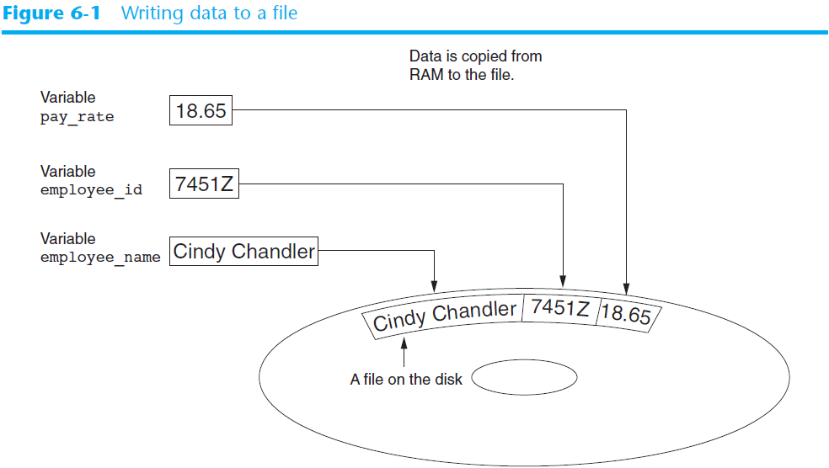

Slide 5
Introduction to File Input and Output (cont’d.)
“Reading data from”: process of retrieving data from a file
Input file: a file from which data is read
Three steps when a program uses a file
  Open the file
  Process the file
  Close the file

Slide 6
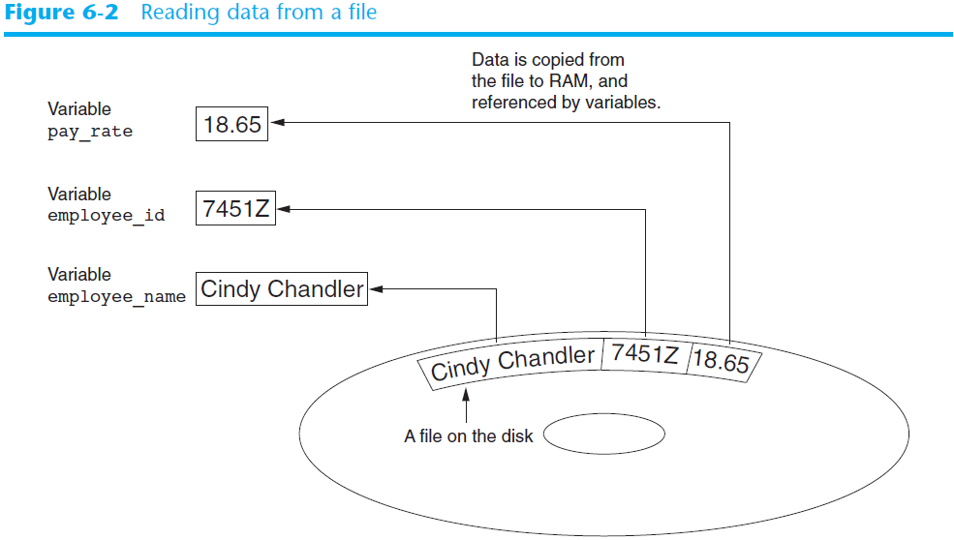

Slide 7
Types of Files and File Access Methods
In general, two types of files
  Text file: contains data that has been encoded as text
  Binary file: contains data that has not been converted to text
Two ways to access data stored in file
  Sequential access: file read sequentially from beginning to end, can’t skip ahead
  Direct access: can jump directly to any piece of data in the file

Slide 8
Filenames and File Objects
Filename extensions: short sequences of characters that appear at the end of a filename preceded by a period
  Extension indicates type of data stored in the file
File object: object associated with a specific file
  Provides a way for a program to work with the file: file object referenced by a variable

Slide 9
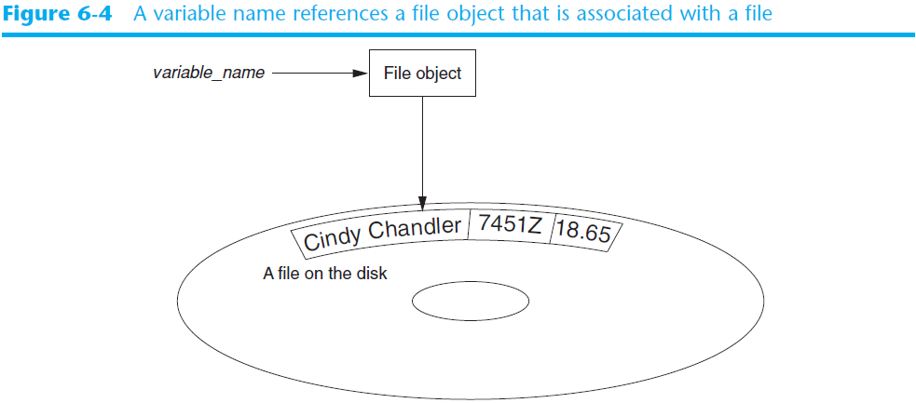
Filenames and File Objects (cont’d.)

Slide 10
Opening a File
open function: used to open a file
  Creates a file object and associates it with a file on the disk
  General format:
  file_object = open(filename, mode)
Mode: string specifying how the file will be opened
  Example: reading only ('r'), writing ('w'), and appending ('a')

Slide 11
Opening a File
Method Name | Use | Explanation
open | open(filename,'r') | Open a file called filename and use it for reading. This will return a reference to a file object.
open | open(filename,'w') | Open a file called filename and use it for writing. This will also return a reference to a file object.
close | filevariable.close() | File use is complete.

Slide 12

Specifying the Location of a File
If open function receives a filename that does not contain a path, assumes that file is in same directory as program
If program is running and file is created, it is created in the same directory as the program
  Can specify alternative path and file name in the open function argument
    Prefix the path string literal with the letter r

Slide 13
Reading Data From a File
read method: file object method that reads entire file contents into memory
  Only works if file has been opened for reading
  Contents returned as a string
readline method: file object method that reads a line from the file
  Line returned as a string, including '\n'
Read position: marks the location of the next item to be read from a file

Slide 14
Reading a File
As an example, suppose we have a text file called olympics.txt that contains the data representing about olympians across different years.
The contents of the file are shown at the bottom of the page.
To open this file, we would call the open function.
The variable, fileref, now holds a reference to the file object returned by open.
When we are finished with the file, we can close it by using the close method.
After the file is closed any further attempts to use fileref will result in an error.

Slide 15
Reading a File
# Open a file named olympics.txt.
fileref = open("olympics.txt","r")
# Other codes here that refer to variable fileref
# Read the file’s contents.
file_contents = fileref.read()
# Close the file.
fileref.close()
# Print the data that was read into memory.
print(file_contents)

Slide 16
Alternative File Reading Methods
Method Name | Use | Explanation
write | filevar.write(astring) | Add astring to the end of the file. filevar must refer to a file that has been opened for writing.
read(n) | filevar.read() | Reads and returns a string of n characters, or the entire file as a single string if n is not provided.
readline(n) | filevar.readline() | Returns the next line of the file with all text up to and including the newline character. If n is provided as a parameter than only n characters will be returned if the line is longer than n.
readlines(n) | filevar.readlines() | Returns a list of strings, each representing a single line of the file. If n is not provided then all lines of the file are returned. If n is provided then n characters are read but n is rounded up so that an entire line is returned.

Slide 17
Reading a File
In this course, we will generally either iterate through the lines returned by readlines() with a for loop, or use read() to get all of the contents as a single string.

Slide 18
Note
A common error that novice programmers make is not realizing that all these ways of reading the file contents, use up the file. After you call readlines(), if you call it again you’ll get an empty list.

Slide 19
Example
Using the file school_prompt.txt, find the number of characters in the file and assign that value to the variable num_char.

Slide 20
Example
Find the number of lines in the file, travel_plans.txt, and assign it to the variable num_lines.

Slide 21
Example
Create a string called first_forty that is comprised of the first 40 characters of emotion_words.txt.

Slide 22
Iterating over lines in a file
A line of a file is defined to be a sequence of characters up to and including a special character called the newline character.
If you evaluate a string that contains a newline character you will see the character represented as \n.
If you print a string that contains a newline you will not see the \n, you will just see its effects

Slide 23
Iterating over lines in a file
As the for loop iterates through each line of the file the loop variable will contain the current line of the file as a string of characters. The general pattern for processing each line of a text file is as follows:
for line in myFile.readlines():
statement1
statement2

Slide 24
Iterating over lines in a file
To process all of our olypmics data, we will use a for loop to iterate over the lines of the file.
Using the split method, we can break each line into a list containing all the fields of interest about the athlete.
We can then take the values corresponding to name, team and event to construct a simple sentence.

Slide 25
Iterating over lines in a file
olympicsfile = open("olympics.txt","r")
for aline in olympicsfile.readlines():
values = aline.split(",")
print(values[0], "is from", values[3], "and is on the roster for", values[4])
olympicsfile.close()

Slide 26
Another Way to Iterate File
olympicsfile = open("olympics.txt","r")
for aline in olympicsfile:
values = aline.split(",")
print(values[0], "is from", values[3], "and is on the roster for", values[4])
olympicsfile.close()

Slide 27
Example
Write code to find out how many lines are in the file emotion_words.txt as shown above. Save this value to the variable num_lines. Do not use the len method.

Slide 28
Finding a File in your Filesystem
In previous examples, our files are stored where the python program is stored.
Thus, we can just write open ('myfile.txt','r').

Slide 29
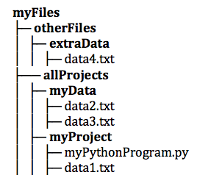
Hierarchy of Folders

Slide 30
Finding a File in your Filesystem
If your file and your Python program are in different directories, however, then you need to specify a path.
open('../myData/data2.txt','r').
The ../ means to go up one level in the directory structure, to the containing folder (allProjects); myData/ says to descend into the myData subfolder.

Slide 31
Finding a File in your Filesystem
There is also an option to use an absolute file path.
For example, suppose the file structure in the figure is stored on a computer in the user’s home directory, 'C:/Users/cihan/Desktop/myFiles'.
Then code in any python program running from any file folder could open data2.txt via open('C:/Users/cihan/Desktop/myFiles/allProjects/myData/data2.txt','r’).

Slide 32
Example
Say you are in a directory called Project. In it, you have a file with your python code. You would like to read in data from a file called "YearlyProjections.csv" which is in a folder called CompanyData, which is inside of Project. What is the best way to open the file in your python program?
A. open("YearlyProjections.csv", "r")
B. open("../CompanyData/YearlyProjections.csv", "r")
C. open("CompanyData/YearlyProjections.csv", "r")
D. open("Project/CompanyData/YearlyProjections.csv", "r")
E. open("../YearlyProjections.csv", "r")

Slide 33
Writing Data to a File
Method: a function that belongs to an object
  Performs operations using that object
File object’s write method used to write data to the file
  Format: file_variable.write(string)
File should be closed using file object close method
  Format: file_variable.close()

Slide 34
Writing Data to a File
Lets say we want to write the result of the following code to a file:
for number in range(1, 21):
square = number * number
print(square)

Slide 35
Writing Data to a File
we need to open a new output file by calling the open function:
outfile = open("squared_numbers.txt",'w')
Once the file has been created, we just need to call the write method passing the string that we wish to add to the file.
outfile.write(str(square)+ '\n')

Slide 36
Example
filename = "squared_numbers.txt"
outfile = open(filename, "w")
for number in range(1, 21):
square = number * number
outfile.write(str(square) + "\n")
outfile.close()
infile = open(filename, "r")
print(infile.read()[:10])

Slide 37
Concatenating a Newline to and Stripping it From a String
In most cases, data items written to a file are values referenced by variables
  Usually necessary to concatenate a '\n' to data before writing it
    Carried out using the + operator in the argument of the write method
In many cases need to remove '\n' from string after it is read from a file
  rstrip method: string method that strips specific characters from end of the string

Slide 38
Appending Data to an Existing File
When open file with 'w' mode, if the file already exists it is overwritten
To append data to a file use the 'a' mode
  If file exists, it is not erased, and if it does not exist it is created
  Data is written to the file at the end of the current contents

Slide 39
Writing and Reading Numeric Data
Numbers must be converted to strings before they are written to a file
str function: converts value to string
Number are read from a text file as strings
  Must be converted to numeric type in order to perform mathematical operations
  Use int and float functions to convert string to numeric value

Slide 40
Using Loops to Process Files
Files typically used to hold large amounts of data
  Loop typically involved in reading from and writing to a file
Often the number of items stored in file is unknown
  The readline method uses an empty string as a sentinel when end of file is reached
    Can write a while loop with the condition
    while line != ''

Slide 41
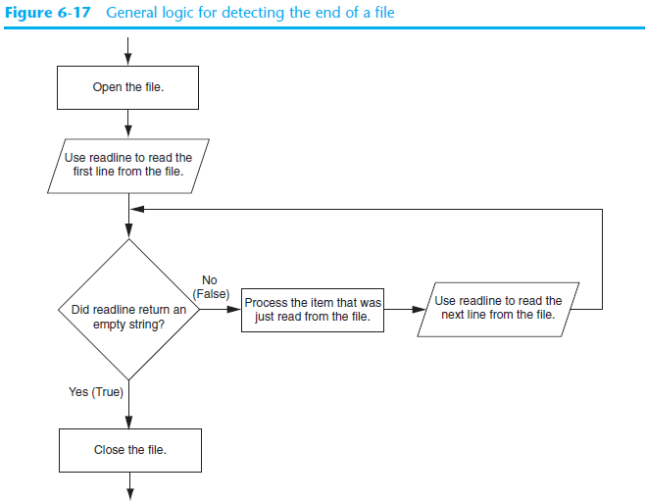

Slide 42
Using Python’s for Loop to Read Lines
Python allows the programmer to write a for loop that automatically reads lines in a file and stops when end of file is reached
  Format: for line in file_object:
  statements
  The loop iterates once over each line in the file

Slide 43
Processing Records
Record: set of data that describes one item
Field: single piece of data within a record
Write record to sequential access file by writing the fields one after the other
Read record from sequential access file by reading each field until record complete

Slide 44
Processing Records (cont’d.)
When working with records, it is also important to be able to:
  Add records
  Display records
  Search for a specific record
  Modify records
  Delete records

Slide 45
CSV Format
CSV stands for Comma Separated Values.
If you print out tabular data in CSV format, it can be easily imported into other programs like Excel, Google spreadsheets, or a statistics package (R, stata, SPSS, etc.).

Slide 46
CSV Format
For example, we can make a file with the following contents. If you save it as a file name grades.csv, then you could import it into one of those programs.
Name,score,grade
Ali,98,A+
Elif,87,B+
Melike,99,A+
Fatih,94,A

Slide 47
Reading in data from a CSV File
We are able to read in CSV files the same way we have with other text files.

Slide 48
Reading in Data from CSV File
fileconnection = open("olympics.txt", 'r')
lines = fileconnection.readlines()
header = lines[0]
field_names = header.strip().split(',')
print(field_names)
for row in lines[1:]:
vals = row.strip().split(',')
if vals[5] != "NA":
print("{}: {}; {}".format(
vals[0],
vals[4],
vals[5]))

Slide 49
Writing to a CSV File
olympians = [("John Aalberg", 31, "Cross Country Skiing"),
("Minna Maarit Aalto", 30, "Sailing"),
("Win Valdemar Aaltonen", 54, "Art Competitions"),
("Wakako Abe", 18, "Cycling")]
outfile = open("reduced_olympics.csv","w")
# output the header row
outfile.write('Name,Age,Sport')
outfile.write('\n')
# output each of the rows:
for olympian in olympians:
row_string = '{},{},{}'.format(olympian[0], olympian[1], olympian[2])
outfile.write(row_string)
outfile.write('\n')
outfile.close()

Slide 50
Exceptions
Exception: error that occurs while a program is running
  Usually causes program to abruptly halt
Traceback: error message that gives information regarding line numbers that caused the exception
  Indicates the type of exception and brief description of the error that caused exception to be raised

Slide 51
Exceptions (cont’d.)
Many exceptions can be prevented by careful coding
  Example: input validation
  Usually involve a simple decision construct
Some exceptions cannot be avoided by careful coding
  Examples
    Trying to convert non-numeric string to an integer
    Trying to open for reading a file that doesn’t exist

Slide 52
Exceptions (cont’d.)
Exception handler: code that responds when exceptions are raised and prevents program from crashing
  In Python, written as try/except statement
    General format: try:
      statements
      except exceptionName:
      statements
    Try suite: statements that can potentially raise an exception
    Handler: statements contained in except block

Slide 53
Exceptions (cont’d.)
If statement in try suite raises exception:
  Exception specified in except clause:
    Handler immediately following except clause executes
    Continue program after try/except statement
  Other exceptions:
    Program halts with traceback error message
If no exception is raised, handlers are skipped

Slide 54
Handling Multiple Exceptions
Often code in try suite can throw more than one type of exception
  Need to write except clause for each type of exception that needs to be handled
An except clause that does not list a specific exception will handle any exception that is raised in the try suite
  Should always be last in a series of except clauses

Slide 55
Displaying an Exception’s Default Error Message
Exception object: object created in memory when an exception is thrown
  Usually contains default error message pertaining to the exception
  Can assign the exception object to a variable in an except clause
    Example: except ValueError as err:
  Can pass exception object variable to print function to display the default error message

Slide 56
The else Clause
try/except statement may include an optional else clause, which appears after all the except clauses
  Aligned with try and except clauses
  Syntax similar to else clause in decision structure
  Else suite: block of statements executed after statements in try suite, only if no exceptions were raised
    If exception was raised, the else suite is skipped

Slide 57
The finally Clause
try/except statement may include an optional finally clause, which appears after all the except clauses
  Aligned with try and except clauses
  General format: finally:
  statements
  Finally suite: block of statements after the finally clause
    Execute whether an exception occurs or not
    Purpose is to perform cleanup before exiting

Slide 58
What If an Exception Is Not Handled?
Two ways for exception to go unhandled:
  No except clause specifying exception of the right type
  Exception raised outside a try suite
In both cases, exception will cause the program to halt
  Python documentation provides information about exceptions that can be raised by different functions

Slide 59
Summary
This chapter covered:
  Types of files and file access methods
  Filenames and file objects
  Writing data to a file
  Reading data from a file and determining when the end of the file is reached
  Processing records
  Exceptions, including:
    Traceback messages
    Handling exceptions

